Slide 1







PREDICTIVE MODELING
Predicting Repository Health with Logistic Regression
Using six activity signals, a binary classifier estimates the probability a repository is Active or Declining.
Commit Velocity
Contributor Count
Monthly commit rate
Total contributors
Active Contributors
Issue Resolution
Last 30 days
Resolution rate
PR Merge Rate
Contributor Churn
Pull request merges
Contributor departure rate

Slide 2
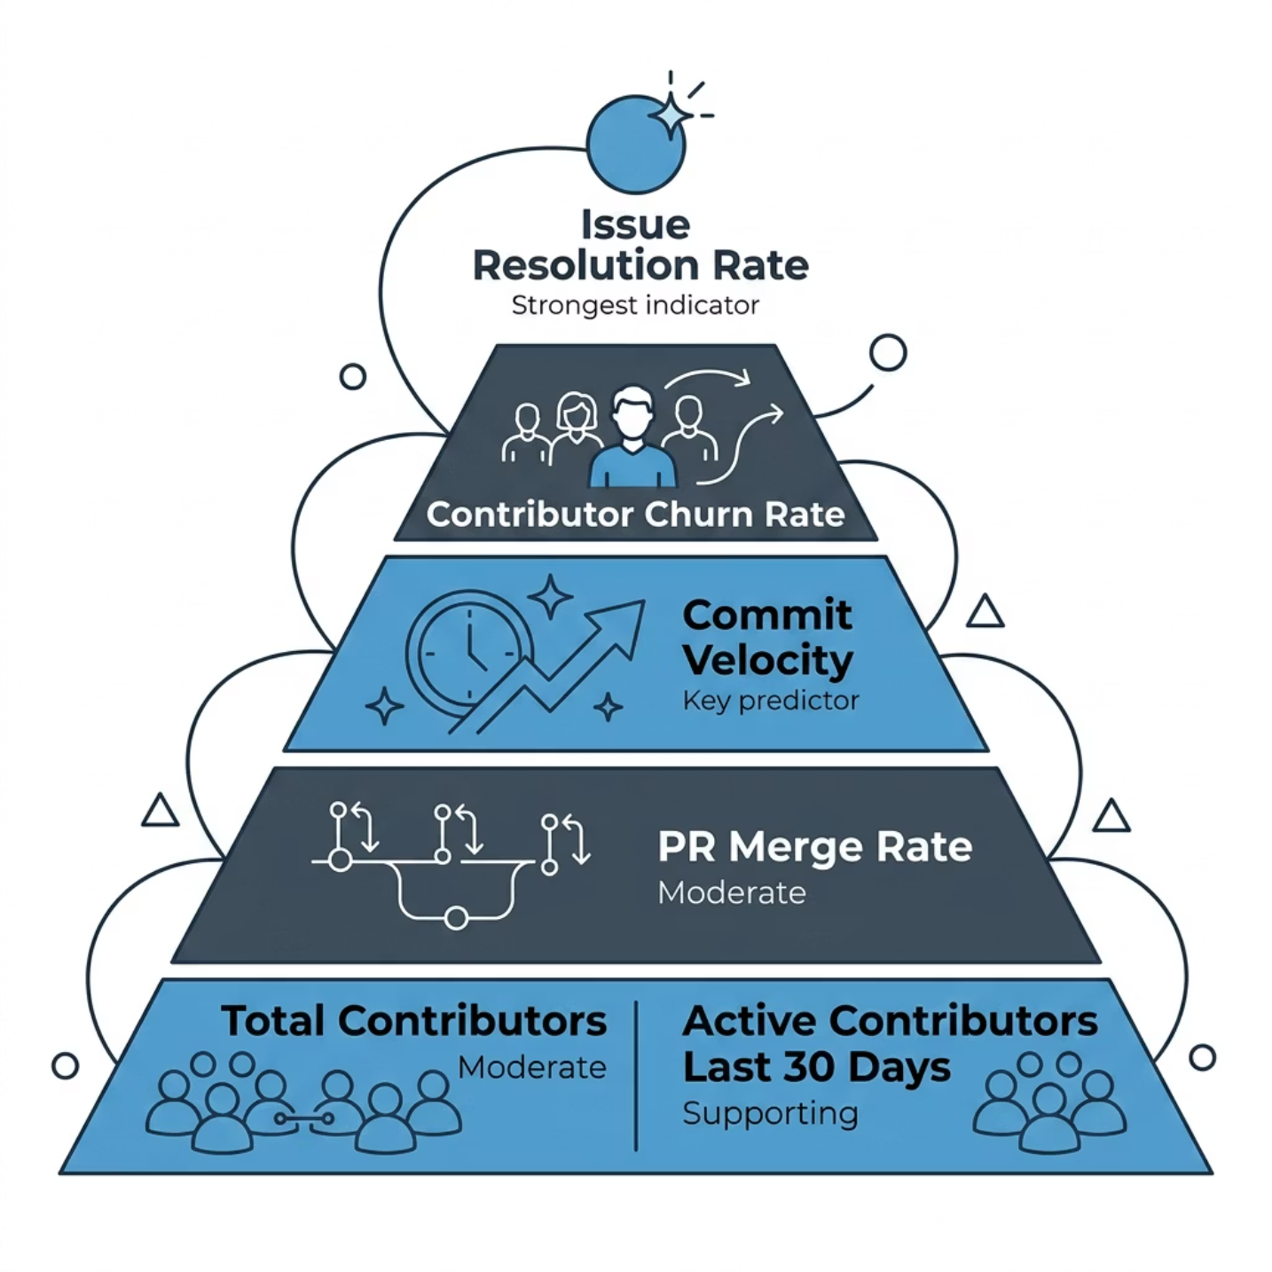


EVALUATION & INSIGHTS
Model Performance & Key Findings
Evaluation: Confusion Matrix
The model correctly classifies a majority of active repositories. Some misclassification occurs for declining ones, indicating moderate accuracy and pattern recognition capability.
Conclusion: Repository sustainability is driven by contributor engagement, activity levels, and issue management efficiency.

